Slide 1



Class: X Lab: 12
Python
Class & Object

Slide 2


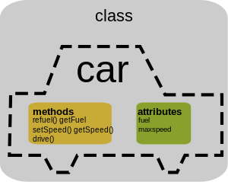
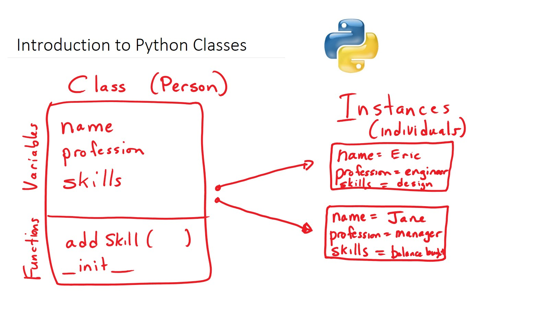
Class
A complete set of properties is a Class. If Car is a
class wheel, steering , sit , body etc. are its property

Slide 3
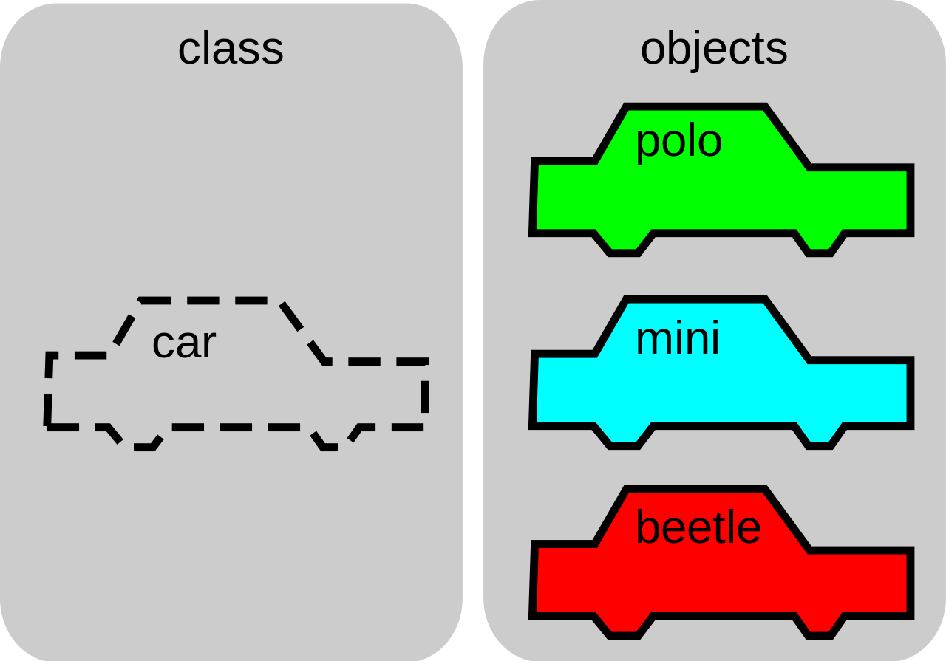
Object
particular instance of a class,
where the object can be a
combination of variables,
functions, and data structures

Slide 4
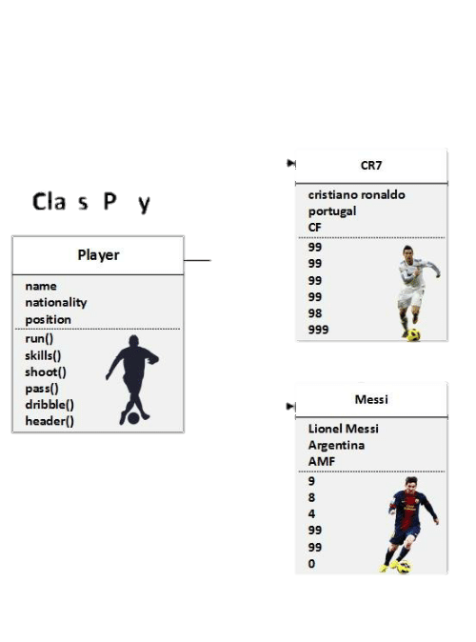
Object vs Class
Object: CR7
Class: Player
Object: Messi

Slide 5
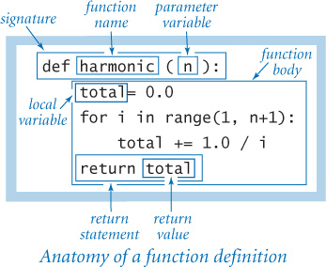
Parameter
A callable object is an
object that can accept
some arguments
(also called parameters)
and possibly return an object

Slide 6
Properties
A callable object is an
object that can accept
some arguments
(also called parameters)
and possibly return an object

Slide 7
